Slide 1
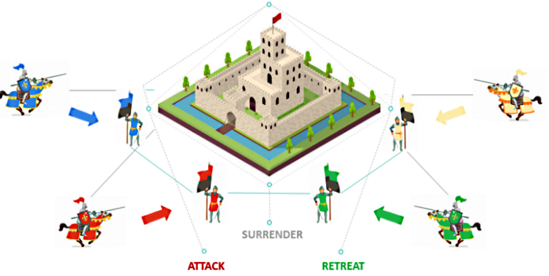
Blocks and Consensus
Loke KS

Slide 2
Videos
But how does bitcoin actually work? - YouTube

Slide 3
Reference
Xu, Weber & Staples (2019), Architecture for Blockchain Applications, Springer Nature Switzerland.
Andreas Antonopoulos (2017), Mastering Bitcoin – programming the open blockchain. O’Reilly.

Slide 4

Summary
Transactions to Blocks
Blocks – how it works
BlockChain
Network consensus
Preventing double spending

Slide 5
Transactions
After the transaction has been created with the necessary locking script (see last lecture), the transaction is transmitted to the bitcoin network.
The purpose of the bitcoin network is to propagate transactions and blocks to all participants.
Any system, such as a server, desktop application, or wallet, that participates in the bitcoin network using the bitcoin protocol is called a bitcoin node.

Slide 6
Transactions
Any bitcoin node that receives a valid transaction it has not seen before will immediately forward it to all other nodes to which it is connected, a propagation technique known as flooding.
The transaction rapidly propagates out across the peer-to-peer network, reaching a large percentage of the nodes.
The transaction propagated on the bitcoin network does not become part of the blockchain until it is verified and included in a block by a process called mining

Slide 7
Peer-to-Peer Network Architecture
Bitcoin is structured as a peer-to-peer network architecture on top of the internet.
The term peer-to-peer, or P2P, means that the computers that participate in the network are peers to each other, that they are all equal, that there are no “special” nodes
There is no server, no centralized service, and no hierarchy within the network. They are all clients.
Nodes in a P2P network both provide and consume services at the same time with reciprocity acting as the incentive for participation. P2P networks are inherently resilient, decentralized, and open.

Slide 8
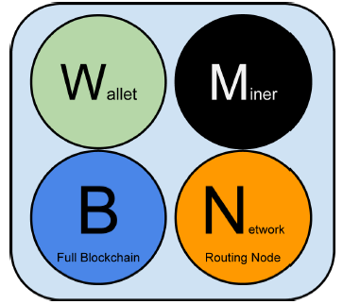
Node Types and Roles
A bitcoin node is a collection of functions: routing, the blockchain database, mining, and wallet services.
Some nodes, called full nodes, also maintain a complete and up-to-date copy of the blockchain.
Full nodes can autonomously and authoritatively verify any transaction without external reference.
Some nodes maintain only a subset of the blockchain and verify transactions using a method called simplified payment verification, or SPV.
These nodes are known as SPV nodes or lightweight nodes

Slide 9
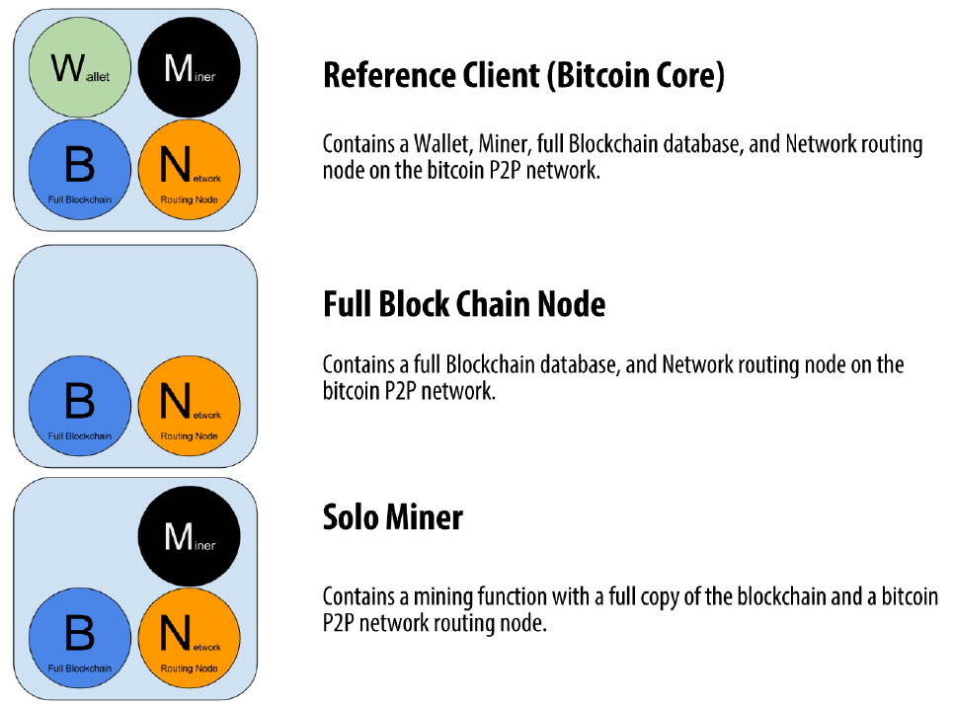

Slide 10
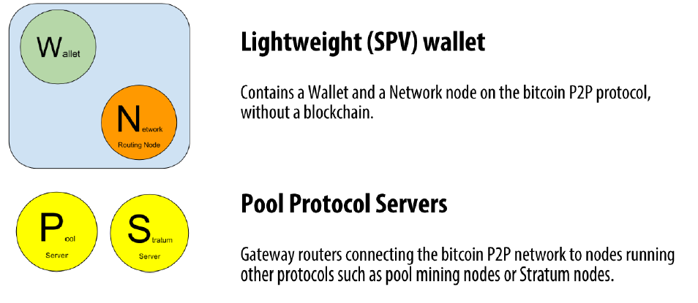

Slide 11
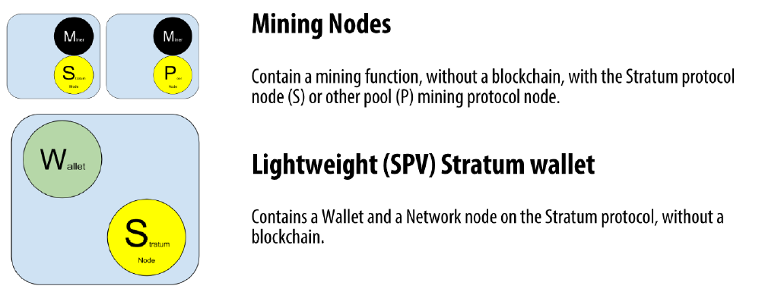

Slide 12
Bitcoin Relay Networks
The Bitcoin Relay Network is a system of peering between nodes in the network by creating a system of high-speed relay nodes for miners and merchants/exchanges.
It acts as a fallback in the case that the public Bitcoin network encounters issues
It decreases block propagation times between miners.
It is NOT designed to in any way replace or decrease the need for the public Bitcoin P2P network.
It is NOT any kind of attempt at centralization
The Bitcoin Relay Network consists of a few nodes scattered around the globe, all of which peer with each other.

Slide 13
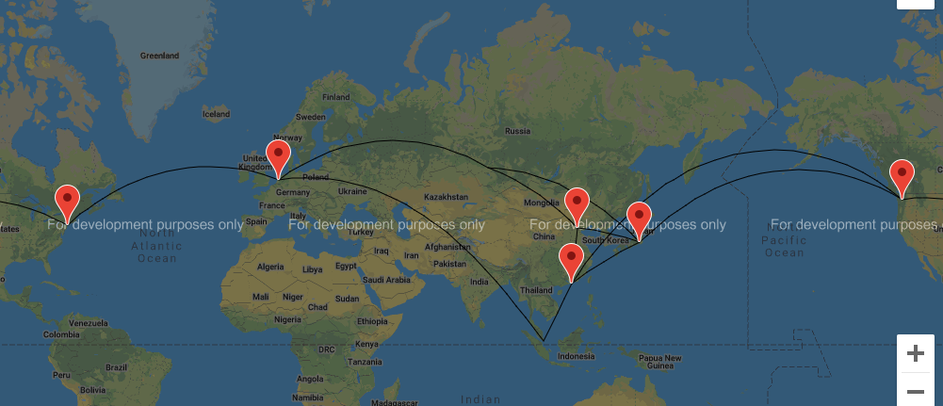
Bitcoin Relay Networks

Slide 14
Network Discovery
When a new node boots up, it must discover other bitcoin nodes on the network in order to participate. To start this process, a new node must discover at least one existing node on the network and connect to it.
One method is to query DNS using a number of “DNS seeds,” which are DNS servers that provide a list of IP addresses of bitcoin nodes

Slide 15
Full node
The first thing a full node will do once it connects to peers is try to construct a complete blockchain by downloading it.
Starting with block #0 (the genesis block), the new node will have to download hundreds of thousands of blocks to synchronize with the network and reestablish the full blockchain.

Slide 16
Simplified Payment Verification (SPV) Nodes
A simplified payment verification (SPV) method is used to allow them to operate without storing the full blockchain – such as used in smartphones.
SPV nodes download only the block headers and do not download the transactions included in each block. The resulting chain of blocks, without transactions, is 1,000 times smaller than the full blockchain.
SPV nodes cannot construct a full picture of all the UTXOs that are available for spending because they do not know about all the transactions on the network.
An SPV node cannot validate whether the UTXO is unspent.

Slide 17
SPV Nodes
An SPV node can definitely prove that a transaction exists but cannot verify that a transaction, such as a double-spend of the same UTXO, doesn’t exist because it doesn’t have a record of all transactions.
To defend against fraud, an SPV node needs to connect randomly to several nodes, to increase the probability that it is in contact with at least one honest node.

Slide 18
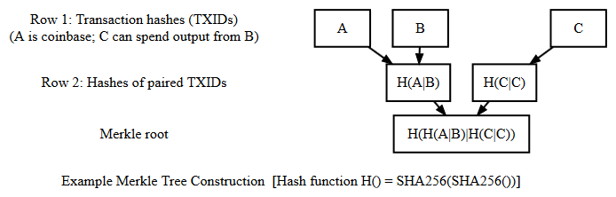
SPV Nodes
The full node would provide C and H(A|B), the SPV can re-derive the Merkle root, allowing it to verify that C is in the block.

Slide 19

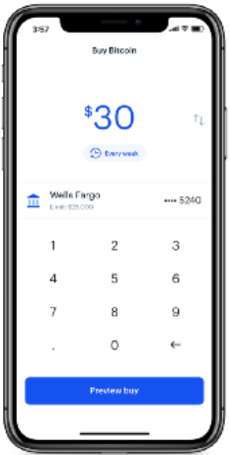


NETWORK
MEMPOOL: Unconfirmed transactions
TX1 TX2 TX3 TX4 TX5
Miner validates and puts transactions into a Block

Slide 20
Mempool
Miners are always listening for new transactions and new blocks, as do all the nodes. When a transaction reaches a mining node, it is verified, included into the mempool, and propagated to the network.
To the miners, the arrival of a new block means the completion of the previous round of competition and an announcement of a winner.
To start mining a new block, the miner first removes the transactions from the mempool that belong to the received block and aggregates a set of the remaining valid transactions into a candidate block

Slide 21
Blocks
The blockchain data structure is an ordered, back-linked list of blocks of transactions.
The blockchain can be stored as a flat file, or in a simple database.
The Bitcoin Core client stores the blockchain metadata using Google’s LevelDB database.
Blocks are linked “back,” each referring to the previous block in the chain

Slide 22
Blocks
Each block within the blockchain is identified by a hash, generated using the SHA256 cryptographic hash algorithm on the header of the block.
Each block also references a previous block, known as the parent block, through the “previous block hash” field in the block header. In other words, each block contains the hash of its parent inside its own header.
The sequence of hashes linking each block to its parent creates a chain going back all the way to the first block ever created, known as the genesis block.

Slide 23
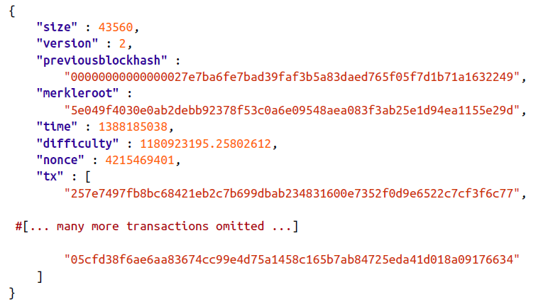
Blocks

Slide 24
Blocks
The “previous block hash” field is inside the block header and thereby affects the current block’s hash.
The child’s own identity changes if the parent’s identity changes.
When the parent is modified in any way, the parent’s hash changes. The parent’s changed hash necessitates a change in the “previous block hash” pointer of the child.

Slide 25
Blocks
This in turn causes the child’s hash to change, which requires a change in the pointer of the grandchild, which in turn changes the grandchild, and so on.
This cascade effect ensures that once a block has many generations following it, it cannot be changed without forcing a recalculation of all subsequent blocks.

Slide 26
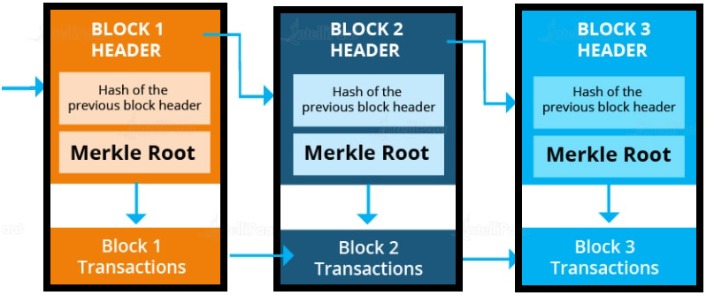
Blockchain

Slide 27
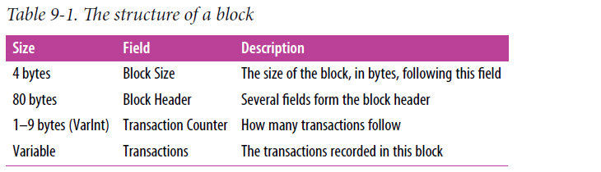
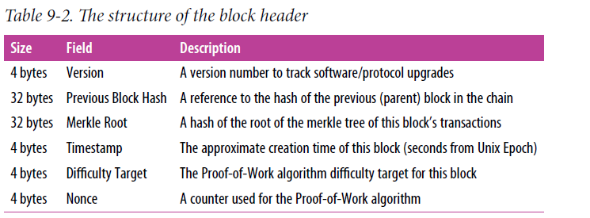
Blocks

Slide 28
Tamper resistant
Recall: each block contains the unique hash of the preceding block which links them together in a ‘chain’.
To change a block or tamper with the data, a fraudulent actor would need to recreate the same block (with the same hash) and regenerate all the successors to that block (including redoing the work that they contain).
This system protects the block from tampering and makes it increasingly more difficult to manipulate data.

Slide 29
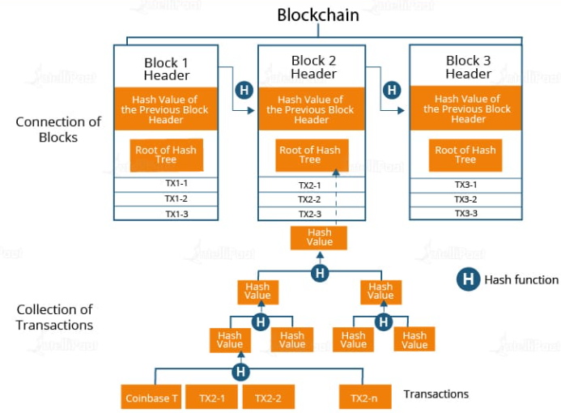
Blockchain

Slide 30
Blockchain
Although a block has just one parent, it can temporarily have multiple children. Each of the children refers to the same block as its parent and contains the same (parent) hash in the “previous block hash” field.
Multiple children arise during a blockchain “fork,” a temporary situation that occurs when different blocks are discovered almost simultaneously by different miners
Eventually, only one child block becomes part of the blockchain and the “fork” is resolved.

Slide 31
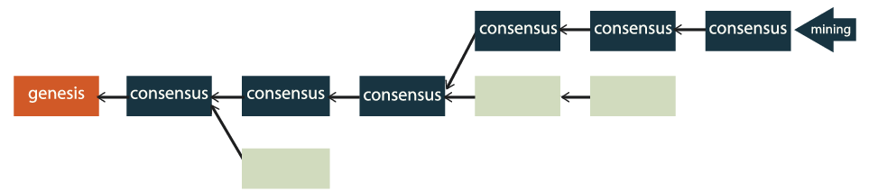
Blockchain
The deeper the block is in the blockchain, the harder it is to modify it, since it would require modifications to every consecutive block.

Slide 32
Merkle Trees
Each block in the bitcoin blockchain contains a summary of all the transactions in the block using a merkle tree.
Merkle trees are used in bitcoin to summarize all the transactions in a block, producing an overall digital fingerprint of the entire set of transactions, providing a very efficient process to verify whether a transaction is included in a block.

Slide 33
Candidate Block
A new block is called a candidate block because it is not yet a valid block, as it does not contain a valid Proof-of-Work.
The block becomes valid only if the miner succeeds in finding a solution to the Proof-of-Work algorithm.

Slide 34
Coinbase
The first transaction in any block is a special transaction, called a coinbase transaction - contains his reward for the mining effort.
The coinbase transaction does not consume (spend) UTXO as inputs.
It has only one input, called the coinbase, which creates bitcoin from nothing.
The coinbase transaction has one output, payable to the miner’s own bitcoin address.
This output can’t be spend until the block becomes 100 blocks deep in the longest chain. This is to incentivize miners to adopt the longest chain.

Slide 35
Mining
To mine for a block is to find a solution to the Proof-of-Work that makes the block valid.
The goal is now to find a value for the nonce that results in a block header hash that is less than the target.
In the simplest terms, mining is the process of hashing the block header repeatedly, changing one parameter, until the resulting hash matches a specific target.
Nonce stands for “number used once”

Slide 36
Mining
The hash function’s result cannot be determined in advance, nor can a pattern be created that will produce a specific hash value.
This feature of hash functions means that the only way to produce a hash result matching a specific target is to try again and again, randomly modifying the input until the desired hash result appears by chance.
The mining node will need to test billions or trillions of nonce values before a nonce is found that satisfies the requirement.

Slide 37
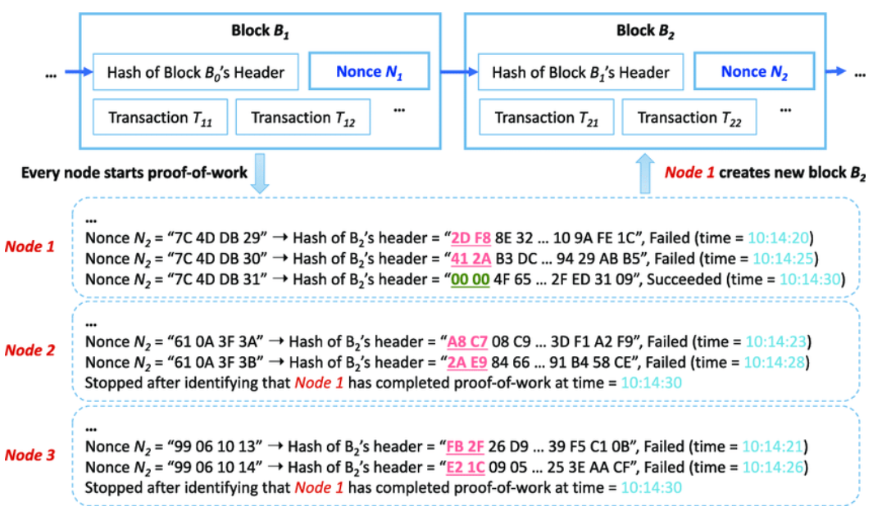
Proof of Work

Slide 38
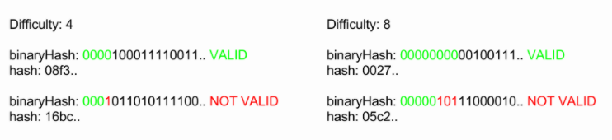
Proof-of-work
The Proof-of-work puzzle is to find a block hash, that has a specific number of zeros prefixing it. The difficulty property defines how many prefixing zeros the block hash must have, in order for the block to be valid. The prefixing zeros are checked from the binary format of the hash.

Slide 39
Example
Target value:
0x0000 0000 0000 0000 0029 d72d 0000 0000 0000 0000 0000 0000 0000 0000 0000 0000
Hash value of Block 538695 :
0x0000 0000 0000 0000 000d 8b40 25c6 3560 88d7 5a7f 3e68 1841 1bab 2b74 8947 dcda
Which is lower than which is a target value.

Slide 40
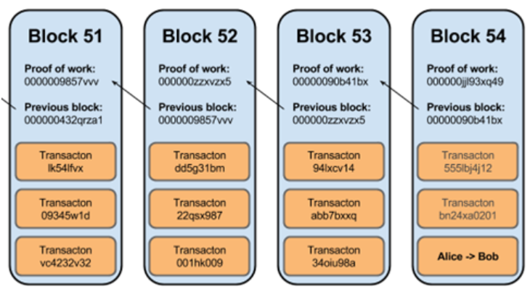
Proof of Work

Slide 41
Proof of Work
“To modify a past block, an attacker would have to redo the proof-of-work of the block and all blocks after it and then catch up with and surpass the work of the honest nodes… the probability of a slower attacker catching up diminishes exponentially as subsequent blocks are added.”- Nakamoto

Slide 42
Proof of Work
Proof of Work also serves as a sort of a public lottery that everybody can verify without using a central authority.
The winner of the Proof of Work gets to insert the block and the coinbase reward.
Since the winner is non deterministic it is hard to predict who the winner is if the hashing power is more or less distributed.
Due to its non-deterministic nature, collusion and cooperation for fraud is reduced we won’t know who can insert the block.

Slide 43
Longest Chainwork
The longest chain is what individual nodes accept as the valid version of the blockchain
The rule that nodes adopt the longest chain of blocks allows every node on the network to agree on what the blockchain looks like, and therefore agree on the same transaction history.
The longest chain is the chain of blocks that took the most effort to build.
This does not necessary mean the chain with the most blocks. We have to take into consideration the difficulty factor.

Slide 44
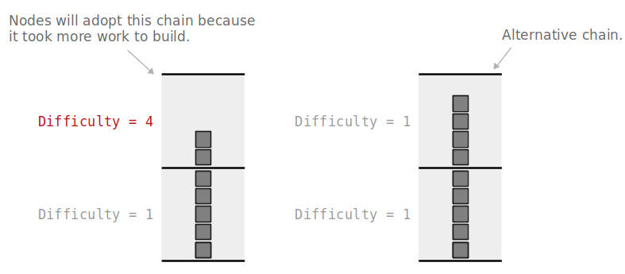
Longest Chainwork
The phrase “longest chain” refers to the blockchain that has taken the most energy to build.

Slide 45
Why adopt the longest chain?
Resolve disagreements when two blocks are mined at the same time.
Protecting blocks already mined on to the blockchain
Miners block reward can only be spent if the block becomes 100 blocks deep in the longest chain.

Slide 46
Why adopt the longest chain?
It is possible for nodes across the network will end up being in disagreement about which of these two blocks should be at the top of the blockchain
This situation can be resolved by having nodes adopt the longest chain of blocks.
This is because the next block to be mined will build upon one of these two blocks, creating a new longest chain that all nodes on the network will be happy to adopt
Adopting the longest available chain means that nodes will always eventually agree on the same view of the blockchain

Slide 47
Why adopt the longest chain?
The fact that nodes always adopt the longest chain as the valid version of the blockchain means that it is very difficult to replace blocks (and therefore transactions) in the chain.
If anyone wanted to replace a transaction in the blockchain, they would need to work to build a new longest chain to replace the current one. However, if the majority of miners are continually working to extend the same current longest known chain, an individual miner won’t be able to compete to outwork all of the other miners.

Slide 48
Why adopt the longest chain?
The bitcoins from this block reward can only be spent if the block becomes 100 blocks deep in the longest chain.
Therefore, this block reward incentivizes miners to always try and mine new blocks that will become part of the longest chain (by always trying to build on to the current longest one).

Slide 49
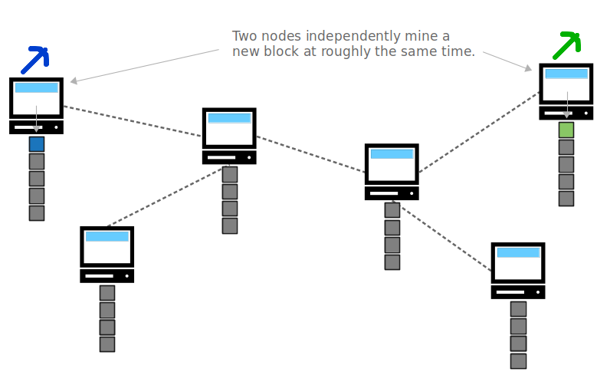
Two blocks have been mined at the same time.

Slide 50
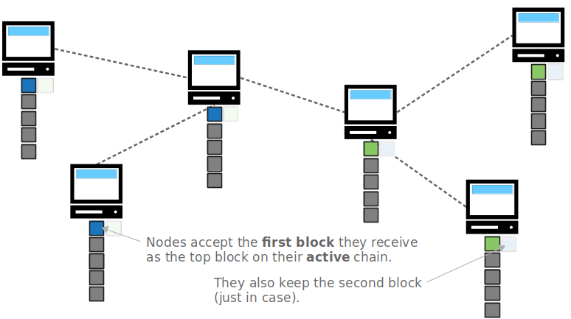
Due to the propagation speed of blocks across the network, some nodes will receive the one block first, and some nodes will receive the other block first. Therefore there will be a disagreement about which of these blocks was actually “first”

Slide 51
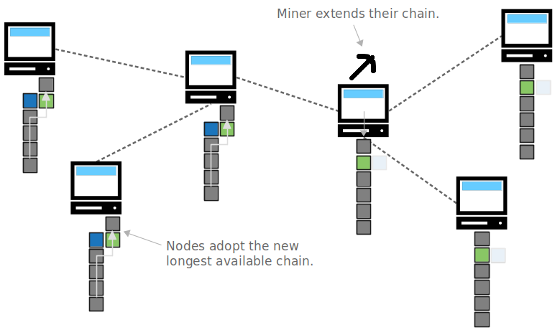
It will be resolved when the next block is mined. The next block to be mined will build on top of one of these blocks, creating a new longest chain. When nodes receive this newest block, they will see that it creates a new longest chain, and will each perform a chain reorganization to adopt it.

Slide 52
Orphan Blocks
Transactions inside blocks that are deactivated due to a chain reorganization (also known as an “orphan blocks”) are no longer part of the transaction history of the blockchain.
If there are transactions in the orphan block that are not in the competing block, they will get sent back in to your node’s memory pool and propagated around the network again for the chance to be mined in to a future block.

Slide 53
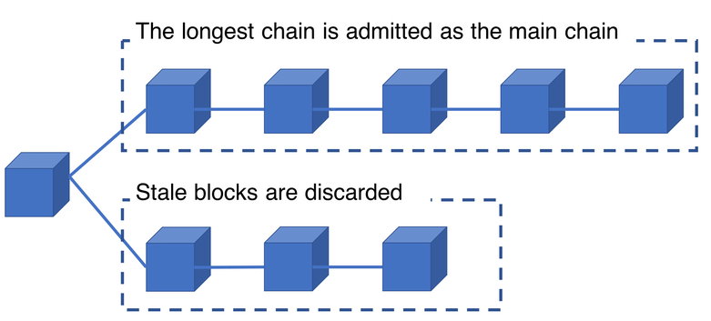
Longest Chain
So by building a new longest chain to replace an existing one, you are effectively rewriting the blockchain and creating a new history of transactions for every node on the network to accept. As a result, you have reversed transactions that we previously thought to have been a permanent part of the blockchain.

Slide 54
51% Attack
A 51% attack describes a situation where a certain miner or mining pool, that owns more than 50% of all the network’s hashing power, acts maliciously to disturb the network’s operation.
A miner employing a 51% attack will be able to:
Double spend his coins.
Prevent transactions from being confirmed.
A miner employing a 51% attack can NOT:
Reverse confirmed transactions.
Create false transactions (that never occurred).
Steal funds from a certain address.
Create new coins.

Slide 55
51% Double Spending
The attacker ‘X’ sends coins to person ‘A’, while sending the same coins to person ‘B’.
While the coins sent to A are publicly displayed on the blockchain, the attacker, who has massive hashing power, secretly mines blocks for the double spend transaction to B, without exposing it to the rest of the network.
After a few confirmations on the public blockchain where transaction A is valid, the attacker presents to the network his hidden mined blocks, where transaction B is valid.
Since he has so much mining power, he can probably create a longer blockchain than the original one and validate his blocks.
In this case, the transaction sent to A will be canceled, since it does not appear on this new, longer blockchain. The result: A ends up with no money, and the attacker may have already gotten the service he paid for.

Slide 56
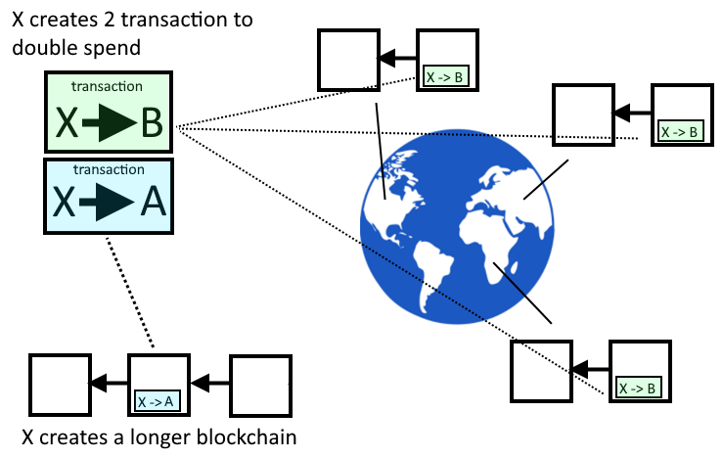
51% Double Spending

Slide 57
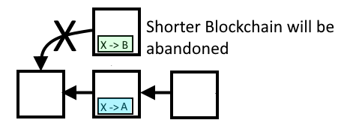
51% Double Spending
When nodes receive this new longer chain of blocks, they will perform a chain reorganization to deactivate blocks in their old longest chain, and activate the blocks in the new longest chain you have given them.

Slide 58
Preventing 51% Attack
Every miner is incentivized to build upon the current longest chain of blocks.
So if the combined mining power of every other miner on the network is greater than yours, it makes it incredibly difficult to be able to outwork the other miners to build a longer chain and replace the existing one.

Slide 59
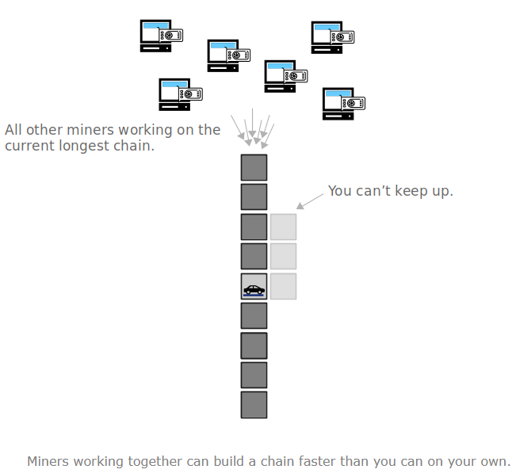
Miners working together can build a chain faster than you can on your own.

Slide 60
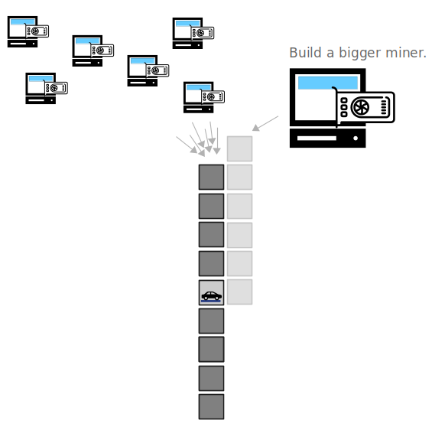
if you can actually acquire more mining power than all other miners combined, then you have the ability to outrun the current longest chain and build a new longer chain for everyone else to adopt.

Slide 61
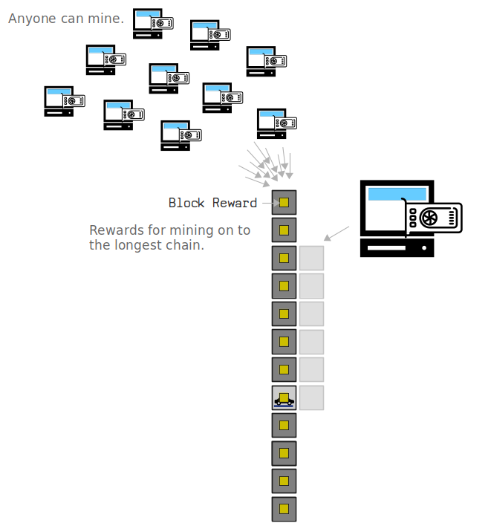
We need to ensure that no single miner has the ability to acquire a majority of the mining power.
This is achieved by allowing anyone in the world to mine, and incentivizing these miners to do so by offering block rewards.

Slide 62
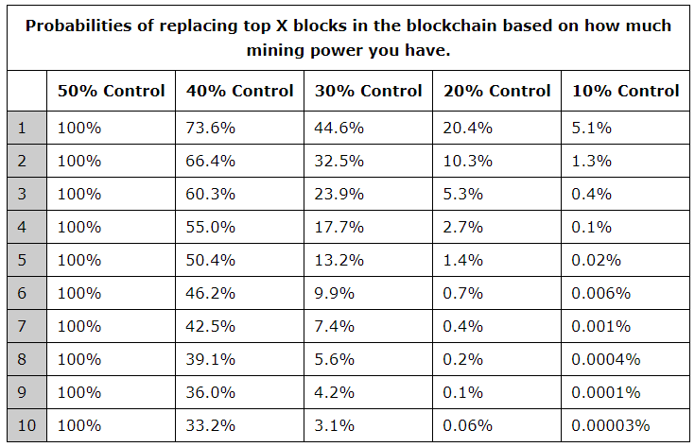
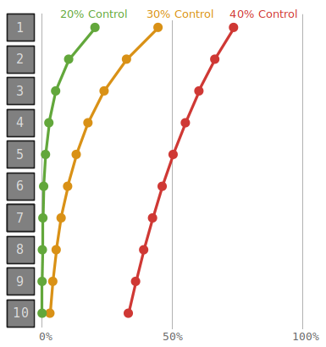
Chances of replacing a mined transaction

Slide 63
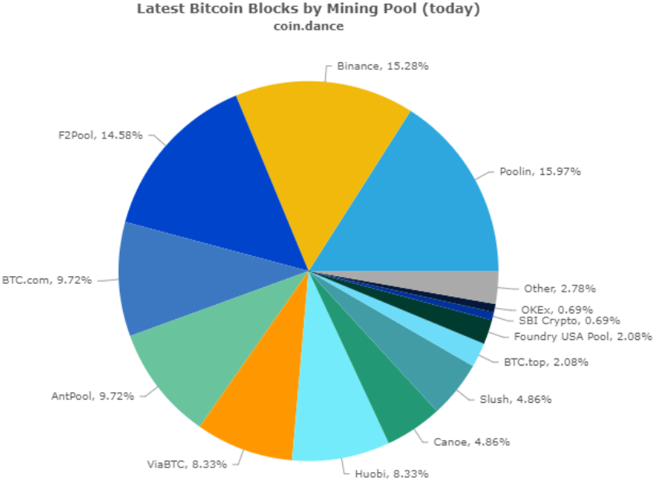
Latest Bitcoin Blocks by Mining Pool
Coin Dance | Latest Bitcoin Blocks by Mining Pool (today) Summary

